Slide 1
Interdependence and
the Gains from Trade
© 2015 Cengage Learning. All Rights Reserved. May not be copied, scanned, or duplicated, in whole or in part, except for use as permitted in a license distributed with a certain product or service or otherwise on a password-protected website for classroom use.

Slide 2
A Parable for the Modern Economy
Only two goods
  Meat
  Potatoes
Only two people
  A cattle rancher named Rose
  A potato farmer named Frank
  Both would like to eat both meat and potatoes
© 2015 Cengage Learning. All Rights Reserved. May not be copied, scanned, or duplicated, in whole or in part, except for use as permitted in a license distributed with a certain product or service or otherwise on a password-protected website for classroom use.

Slide 3
A Parable for the Modern Economy
If Rose produces only meat and Frank produces only potatoes
  Both gain from trade
If both Rose and Frank produce both meat and potatoes
  Both gain from specialization and trade
Production possibilities frontier
  Various mixes of output that an economy can produce
© 2015 Cengage Learning. All Rights Reserved. May not be copied, scanned, or duplicated, in whole or in part, except for use as permitted in a license distributed with a certain product or service or otherwise on a password-protected website for classroom use.

Slide 4
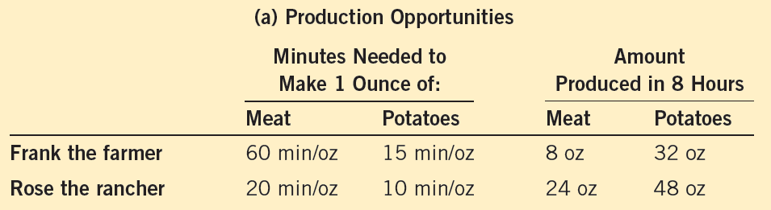
Figure 1
The Production Possibilities Frontier (a)
Panel (a) shows the production opportunities available to Frank the farmer and Rose the rancher.
© 2015 Cengage Learning. All Rights Reserved. May not be copied, scanned, or duplicated, in whole or in part, except for use as permitted in a license distributed with a certain product or service or otherwise on a password-protected website for classroom use.

Slide 5
Figure 1
The Production Possibilities Frontier (b, c)
(b) Frank’s production
possibilities frontier
(c) Rose’s production
possibilities frontier
Meat (oz)
Meat (oz)
If there is no trade, Frank chooses this production and consumption.
If there is no trade, Rose chooses this production and consumption.
24
8
12
B
4
A
0
16
32
0
24
48
Potatoes (oz)
Potatoes (oz)
Panel (b) shows the combinations of meat and potatoes that Frank can produce. Panel (c) shows the combinations of meat and potatoes that Rose can produce. Both production possibilities frontiers are derived assuming that Frank and Rose each work 8 hours per day. If there is no trade, each person’s production possibilities frontier is also his or her consumption possibilities frontier.
© 2015 Cengage Learning. All Rights Reserved. May not be copied, scanned, or duplicated, in whole or in part, except for use as permitted in a license distributed with a certain product or service or otherwise on a password-protected website for classroom use.

Slide 6
A Parable for the Modern Economy
Specialization and trade
  Farmer Frank specializes in growing potatoes
    More time growing potatoes
    Less time raising cattle
  Rancher Rose specializes in raising cattle
    More time raising cattle
    Less time growing potatoes
  Trade: 5 oz of meat for 15 oz of potatoes
© 2015 Cengage Learning. All Rights Reserved. May not be copied, scanned, or duplicated, in whole or in part, except for use as permitted in a license distributed with a certain product or service or otherwise on a password-protected website for classroom use.

Slide 7
Figure 2
How Trade Expands the Set of Consumption Opportunities (a, b)
(a) Frank’s production
and consumption
(b) Rose’s production
and consumption
Meat (oz)
Meat (oz)
Frank's production and consumption without trade
Rose’s production with trade
Rose’s production and consumption without trade
24
Frank's consumption with trade
18
8
Rose’s consumption with trade
13
B*
A*
12
5
Frank's production with trade
B
4
A
0
16
17
32
0
12
24
27
48
Potatoes (oz)
Potatoes (oz)
The proposed trade between Frank the farmer and Rose the rancher offers each of them a combination of meat and potatoes that would be impossible in the absence of trade. In panel (a), Frank gets to consume at point A* rather than point A. In panel (b), Rose gets to consume at point B* rather than point B. Trade allows each to consume more meat and more potatoes.
© 2015 Cengage Learning. All Rights Reserved. May not be copied, scanned, or duplicated, in whole or in part, except for use as permitted in a license distributed with a certain product or service or otherwise on a password-protected website for classroom use.

Slide 8
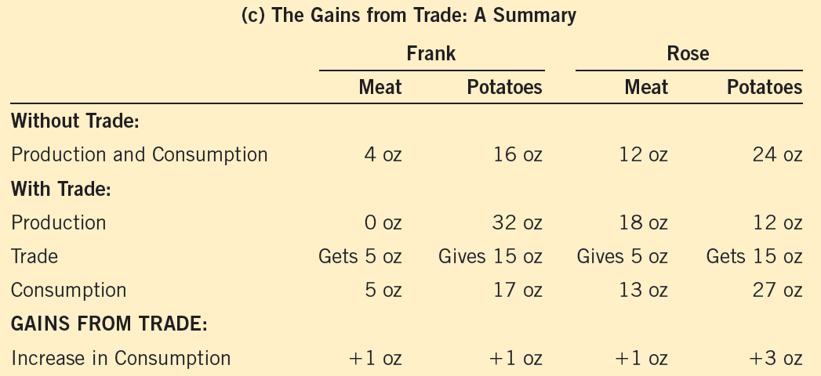
Figure 2
How Trade Expands the Set of Consumption Opportunities (c)
The proposed trade between Frank the farmer and Rose the rancher offers each of them a combination of meat and potatoes that would be impossible in the absence of trade. In panel (a), Frank gets to consume at point A* rather than point A. In panel (b), Rose gets to consume at point B* rather than point B. Trade allows each to consume more meat and more potatoes.
© 2015 Cengage Learning. All Rights Reserved. May not be copied, scanned, or duplicated, in whole or in part, except for use as permitted in a license distributed with a certain product or service or otherwise on a password-protected website for classroom use.

Slide 9
Comparative Advantage
Absolute advantage
  The ability to produce a good using fewer inputs than another producer
  In producing meat: Rose
    Rose needs 20 min. to produce 1 oz. of meat
    Frank needs 60 minutes
  In producing potatoes: Rose
    Rose needs 10 min. to produce 1 oz. of potatoes
    Frank needs 15 minutes
© 2015 Cengage Learning. All Rights Reserved. May not be copied, scanned, or duplicated, in whole or in part, except for use as permitted in a license distributed with a certain product or service or otherwise on a password-protected website for classroom use.

Slide 10
Comparative Advantage
Opportunity cost
  Whatever must be given up to obtain some item
  Measures the trade-off between the two goods that each producer faces
© 2015 Cengage Learning. All Rights Reserved. May not be copied, scanned, or duplicated, in whole or in part, except for use as permitted in a license distributed with a certain product or service or otherwise on a password-protected website for classroom use.

Slide 11
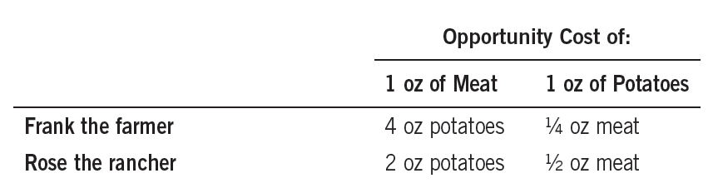
Table 1
The Opportunity Cost of Meat and Potatoes
© 2015 Cengage Learning. All Rights Reserved. May not be copied, scanned, or duplicated, in whole or in part, except for use as permitted in a license distributed with a certain product or service or otherwise on a password-protected website for classroom use.

Slide 12
Comparative Advantage
Comparative advantage
  The ability to produce a good at a lower opportunity cost than another producer
  Reflects the relative opportunity cost
Principle of comparative advantage
    Each good should be produced by the individual that has the smaller opportunity cost of producing that good
  Specialize according to comparative advantage
© 2015 Cengage Learning. All Rights Reserved. May not be copied, scanned, or duplicated, in whole or in part, except for use as permitted in a license distributed with a certain product or service or otherwise on a password-protected website for classroom use.

Slide 13
Comparative Advantage
One person
  Can have absolute advantage in both goods
  Cannot have comparative advantage in both goods
For different opportunity costs
    One person has comparative advantage in one good
    The other person has comparative advantage in the other good
© 2015 Cengage Learning. All Rights Reserved. May not be copied, scanned, or duplicated, in whole or in part, except for use as permitted in a license distributed with a certain product or service or otherwise on a password-protected website for classroom use.

Slide 14
Comparative Advantage
Opportunity cost of one good
  Inverse of the opportunity cost of the other
Gains from specialization and trade
  Based on comparative advantage
  Total production in economy rises
    Increase in the size of the economic pie
    Everyone is better off
© 2015 Cengage Learning. All Rights Reserved. May not be copied, scanned, or duplicated, in whole or in part, except for use as permitted in a license distributed with a certain product or service or otherwise on a password-protected website for classroom use.

Slide 15
Comparative Advantage
Trade can benefit everyone in society
  Allows people to specialize
The price of trade
  Must lie between the two opportunity costs
Principle of comparative advantage explains:
  Interdependence
  Gains from trade
© 2015 Cengage Learning. All Rights Reserved. May not be copied, scanned, or duplicated, in whole or in part, except for use as permitted in a license distributed with a certain product or service or otherwise on a password-protected website for classroom use.

Slide 16
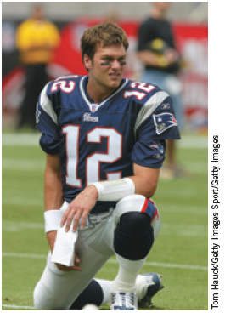
Applications of Comparative Advantage
Should Tom Brady Mow His Own Lawn?
Brady, in 2 hours
  Mow his lawn, or
  Film a TV commercial, earn $20,000
Forest Gump, in 4 hours
  Mow Brady’s lawn
  Work at McDonald’s, earn $40
“ They did a nice job mowing this grass.”
© 2015 Cengage Learning. All Rights Reserved. May not be copied, scanned, or duplicated, in whole or in part, except for use as permitted in a license distributed with a certain product or service or otherwise on a password-protected website for classroom use.

Slide 17
Applications of Comparative Advantage
Should the U.S. trade with other countries?
Imports
  Goods produced abroad and sold domestically
Exports
  Goods produced domestically and sold abroad
© 2015 Cengage Learning. All Rights Reserved. May not be copied, scanned, or duplicated, in whole or in part, except for use as permitted in a license distributed with a certain product or service or otherwise on a password-protected website for classroom use.

Slide 18
Applications of Comparative Advantage
Should the U.S. trade with other countries?
U.S and Japan
  Each produces food and cars
  One American worker, one month
    One car, or
    Two tons of food
  One Japanese worker, one month
    One car
    One ton of food
© 2015 Cengage Learning. All Rights Reserved. May not be copied, scanned, or duplicated, in whole or in part, except for use as permitted in a license distributed with a certain product or service or otherwise on a password-protected website for classroom use.

Slide 19
Applications of Comparative Advantage
Principle of comparative advantage
  Each good should be produced by the country with the smaller opportunity cost of producing that good
Specialization and trade
  All countries have more food and more cars
© 2015 Cengage Learning. All Rights Reserved. May not be copied, scanned, or duplicated, in whole or in part, except for use as permitted in a license distributed with a certain product or service or otherwise on a password-protected website for classroom use.

